Slide 1
Future Certification of Automated/Autonomous Driving Systems
2019/01/28 - 2019/01/01, GRVA-02
Submitted by the experts of OICA

Slide 2
Introduction

Slide 3
Introduction
With the introduction of automated driving systems complexity and thereby the number of software-based functions will continue to increase.
Compared to conventional vehicles, the potentially affected safety-areas and variances of scenarios will increase and cannot fully be assessed with a limited number of tests that are performed on a test track or test bench
The aim of this presentation is to develop new innovative certification methods to demonstrate a sufficient safety-level and reliability which allows for safe market introduction The aim of this presentation is to propose a new innovative certification scheme allowing to demonstrate the level of safety and reliability which allows for safe market introduction of automated/autonomous vehicles
The concept and building blocks for a future certification of automated/autonomous driving systems that are discussed in this presentation could be applied both under a type approval or self-certification regime
Application of a regulation under a self-certification regime requires precise descriptions of the procedures and tests to be applied by the manufacturer
This presentation is based on several documents that OICA submitted under the activities of WP.29 IWG ITS/AD and the former TF AutoVeh including its subgroups 1 and 2

Slide 4
General Challenges/Premises for a suitable Approach to Regulate Automated Driving
It is important to consider that WP.29 GRVA is aiming at regulating new technologies of which the majority is not available on the market yet
→ lack of experience should not be neglected and tackled with reasonable strategies (e.g. generic safety-approaches/requirements) in order to guarantee the highest possible level of safety.
It will be difficult to regulate each and every topic in detail from the early beginning
→ need to prioritize the different topics
→ start with a first set of requirements and develop further as the experience and data on new technologies grow
Technology for Automated/Autonomous Driving Systems will continue to evolve rapidly over the next years
→ need flexible structures that can be applied to the different kinds of L3-L5 systems instead of limiting the variation/innovation of different kinds of systems by design restrictive requirements from the early beginning
→ Regulating “function by function” would frequently require formal frequent updates/ upgrades of regulations and would therefore not be practical. Furthermore, it could easily become and highly design restrictive
Need to find a pragmatic way for industry and authorities that on the one hand leaves “controlled” flexibility and on the other hand defines reasonable requirements/principles to allow evolution of the new technology within the agreed safety principles over the next years
structure should allow to add output of research initiatives and lessons learned at a later stage

Slide 5
Comparison of published Safety Principles
Safety Principles |  | USA (NHTSA FAVP 3.0) | Japan (MLIT-Guideline) | Canada (Transport Canada) | Europe (EC Guidance)
 |  |  | Vision: “0” accidents with injury or fatality by ADV Ensure Safety : Within ODD ADV shall not cause rationally foreseeable & preventable accidents
1 | Safe Function (Redundancy) | 1) System Safety 9) Post Crash Behavior | ii) System safety by redundancy | 6) Safety systems (and appropriate redundancies) | 7) Safety assessment – redundancy; safety concept
2 | Safety Layer | 3) (OEDR) | ii) Automatic stop in situations outside ODD iii) Compliance with safety regulation iii) Compliance with standards recommended vii) for unmanned services: camera link & notification to service center | 4) International standards and best practices | 2) Driver/operator/ passenger interaction - takeover delay; camera & voice link for driverless systems
3 | Operational Design Domain | 2) Operational Design Domain | i) Setting of ODD | 2) Operational design domain | 1) System performance in automated mode – description 2) Driver/operator/ passenger interaction – boundary detection
4 | Behavior in Traffic | 3) OEDR 12) Federal, State and local Laws |  | 3) OEDR | 1) System performance in automated mode – behavior 4) MRM – traffic rules; information
5 | Driver‘s Responsibilities |  | iv) HMI – driver monitoring for conditional automation | 1) Level of automation and intended use 7) HMI and access of controls – accidental misuse | 2) Driver/operator/ passenger interaction – information; driver monitoring
6 | Vehicle Initiated Take-Over | 4) Fallback (MRC) 6) HMI | ii) Automatic stop in situations outside ODD iv) HMI – inform about planned automatic stop |  | 3) Transition of driving task – lead time; MRM; HMI 4) MRM
7 | Driver Initiated Transfer | 6) HMI |  | 7) HMI and Accessibility of Controls | 1) System performance in automated mode - takeover
8 | Effects of Automation |  |  | 7) HMI and Accessibility of Controls – unsafe misuse
9 | Safety Certificate |  | viii) Safety evaluation via simulation, track & real world testing ix) In-use safety - inspection | 5) Testing and validation 11) After market repairs / modifications | 7) Safety assessment – product; processes; risk assessment; standards
10 | Data Recording | 10) Data Recording | v) Installation of data recording devices | 12) User privacy 13) Collaboration with government agencies & law enforcement | 5) Data storage system
11 | Security | 7) Vehicle Cybersecurity | vi) Cybersecurity – safety by design ix) In-use safety – software update | 10) Cyber security 11) System update | 6) Cyber security
12 | Passive Safety | 8) Crashworthiness |  | 9) User protection during collision & system failure
13 | Driver‘s training | 11) Consumer Education/Training | x) Information provision to users | 8) Public education and awareness | 8) information provision to users
Conclusion:
General safety-frameworks are available. They are not design-restrictive and could be further explored for regulatory use at UNECE
→ Internationally harmonized safety principles endeavored by OICA

Slide 6
“Classical” Certification Approach

Slide 7
“Classical” Certification Approach
Example: Tires UN-R 30 and 54; UN-R 117
Tire tests (“classical approach”):
Mechanical strength: Load/speed performance tests
Rolling sound emission values in relation to nominal section width and category of use
Adhesion on wet surfaces (wet and snow grip index)
Rolling resistance
The “classical certification approach” typically defines a limited number of performance criteria and physical certification tests to set-up a minimum the necessary safety-level as hurdle prerequisite for market entrance
Such tests are completely performed on test tracks or on a test bench, requirements were refined over years
Approach is useful well suited for systems with limited complexity, limited interactions with other systems and clearly defined system boundaries (typical for mechanical systems/components)

Slide 8
Existing Extension of the “Classical” Certification Approach
Comment: Bellow's reference to Annex 8 is in line with 13-H . One example sufficient.
Example: Performance of a braking system (UN-R 13 and 13-H)
Braking Tests (“classical approach”):
Min. deceleration: 6,43 m/s² and 2,44 m/s² for the fallback secondary braking system
Stopping distance in relation to initial speed: 60 m for 100 km/h
Parking brake to hold the laden vehicle stationary on a 20% up or down gradient
When ABS, ESP and Brake-Assist were regulated, it was realized that the “classical approach” was not able to address all safety-relevant areas of electric/electronic systems due to the high number of failures/scenarios:
This led to the introduction of the process- and functional safety oriented audits: Annex 8 for safety of complex electronic vehicle control systems
Introduction of simulation as acceptable simulation-approach for ESP
→ It should also be noted that when UN-R 13-H was updated regarding electronic control systems like ABS and ESP, such technologies were already deployed for some years and technically standardized (long-term-experience was available)

Slide 9
Further Extension of the “Classical” Certification Approach
Why the testing of the automated driving systems requires new elements:
The system complexity and thereby the number of software-based functions will continue to increase with automated driving systems. Compared to the complex electronic control systems, the potentially affected safety-areas and variances of scenarios will further increase and cannot fully be assessed with a limited number of tests that are performed on a test track or test bench.
The existing audit-approach that was already taken used for electronic control systems that is today applied for both in safety systems (e.g. ABS, ESP) and for driver assistance systems (L1, L2) should be further extended and upgraded to tackle L3-L5 systems.
Why elements of the “classical” approach are still necessary:
Testing of existing conventional safety-regulations should continue with the “classical approach” also for vehicles that are equipped with automated driving systems.
Furthermore Besides, classical certification elements (track testing) are an essential part of complement the three-pillar approach (see from slide 14). The Additions are needed to appropriately cover the software related aspects – they will augment and not replace the classical certification approach

Slide 10
Paradigm shift - new approach required
Manual and assisted Driving
Conditional Driving Automation
High/Full Driving Automation
„Classical“ approach (for a single system/component)
„Classical“ approach
(for a single system/component)
„Classical“ approach (for a single system/component)
Comment: Added the frame lines to “classical” approach, driving capabilities and driving permit. Otherwise the upper text “classical” approach looks like a headline to the whole box
Driving capabilities
Driving capabilities
Driving capabilities + more...
Driving capability (DDT, OEDR) with the system during operation, but handover to driver necessary
Confirmed through
Audit/Assessment
Physical Certification Tests
Real-World-Test Drive
Driving Permit
Driving Permit
Theoretical Test
Practical test
Excerpt of driver‘s capabilities
Theoretical Test
Practical test
Excerpt of driver‘s capabilities
New approach for future certification
e.g. vehicle with ADAS support (L1/L2)
e.g. vehicle with ACSF B2 (L3)
e.g. vehicle with L4 system without conventional driver

Slide 11
Academia views on why a different approach is needed
Propose to shift this slide to back-up – to much details for GRVA
Autonomous vehicles would have to be driven hundreds of millions of miles and sometimes hundreds of billions of miles to demonstrate their reliability in terms of fatalities and injuries — an impossible proposition if the aim is to demonstrate their performance prior to releasing them on the roads for consumer use and even then, this would not ensure that all safety-relevant situations occurred. (see e.g. also next slide based on German accident data base)
Developers of this technology and third-party testers will need to develop innovative methods of demonstrating safety and reliability.
In parallel to developing new testing methods, it is imperative to develop adaptive regulations that are designed from the outset to evolve with the technology so that society can better harness the benefits and manage the risks of these rapidly evolving and potentially transformative technologies.
Source: See e.g. research conducted by Prof. Dr. Hermann Winner (Technical University Darmstadt) and publication by RAND Corporation, 2016

Slide 12
Challenge of validation. Statistics Mileage and Accidents
Propose to shift this slide to back-up – to much details for GRVA – may need to much explanation
Accident Statistics Germany (Destatis 2016):
726 bn km total mileage
13,341 km annual mileage per driver
2,277,182 material damages
329,240 slightly injured
67,426 severely injured
3,206 fatalities
material damage: 0.3 mn km
slightly personal damage: 2.2 mn km
severe personal damage: 11 mn km
fatal accident: 226 mn km
0
50 mn
100 mn
150 mn
200 mn
250 mn
average annual mileage : 0.013 mn km;
average mileage lifetime: 0.7 mn km (~50 years x 13tsd km)
near accidents (schematic)

Slide 13
Overview: Concept for ADS Certification

Slide 14
Concept for certification – the three pillars
Comment: Updated the design of the boxes a little bit to make the text "Real World -Test Drive graphically fit into the colored area
overall impression of system behavior on public roads
assessment of system‘s ability to cope with real world traffic situations with a standardized checklist
„driving license test“ for automated driving system
guidance through given set of situations which shall be passed
Real- World- Test Drive
Physical Certification Tests
Audit and Assessment
matching of audit/assessment results with real world behavior
assessment of system behavior in fixed set of challenging cases, which either aren‘t testable on public roads or cannot be guaranteed to occur during the real world test drive.
reproducibility of situations is given
audit of development process (methods, standards)
assessment of safety concept (functional safety, safety of use) and measures taken
check of integration of general safety requirements and traffic rules
use of simulation results (high mileage approval, capability to cope with critical situations, which aren‘t testable on proving grounds or in public)
assessment of development data/field testing, OEM-self-declarations
Simulation
certification depends on all three pillars – partial assessment doesn‘t have significance
scope of work should reduce with every step (audit/assessment: largest scope – real world test drive: final confirmation)
safety for test witnesses and other road users – no endangering tests on public roads

Slide 15
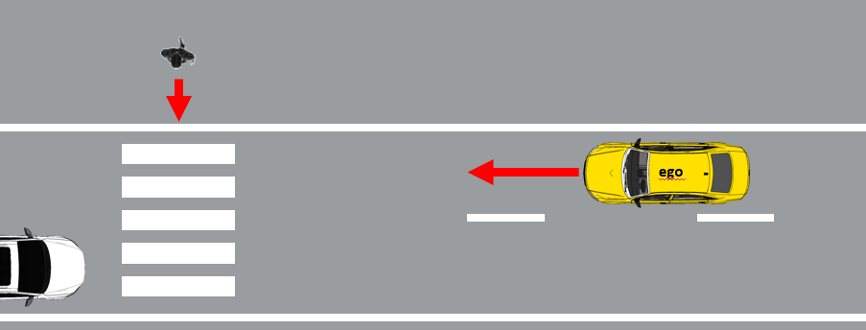
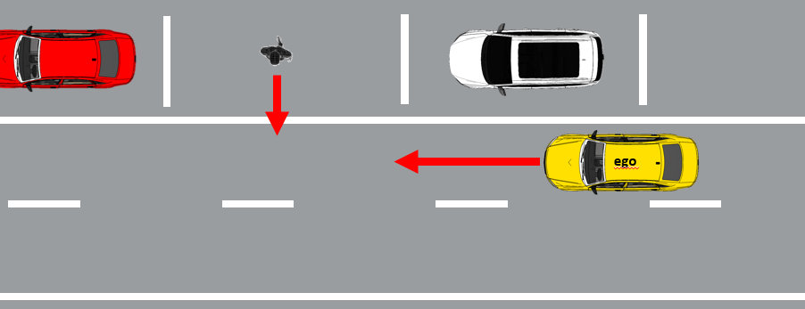
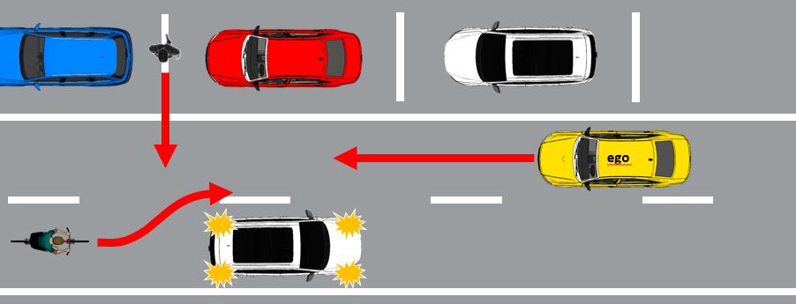
Example of the different pillars’ functions
Typical traffic scenarios
Real World Test Drive
Pedestrian crossing a crosswalk
Critical traffic scenarios
Physical Certification Tests
Scenario probability of occurrence in real world traffic
Obstructed pedestrian crossing
Edge case scenarios
Audit and Assessment (e.g. simulation)
low probability, but high efforts to identify and confirm performance!
Complexity/risk of scenario
Obstructed pedestrian crossing + cyclist overtaking

Slide 16
Concept for certification – the three pillars and their individual purpose
Audit/Assessment
Understand the system to be certified
Assess that the applied processes and design/test methods for the overall system development (HW and SW) are effective, complete and consistent
Assess system’s strategies/rest performance to address (multiple) fault-conditions and disturbances due to deteriorating external influences; vehicle behavior in variations of critical scenarios
Simulation: Test parameter variations (e.g. distances, speeds) of scenarios and edge-cases that are difficult to test entirely on a test track
Physical Certification Tests
Assess critical scenarios that are technically difficult for the system, have a high injury severity and are representative for real traffic
Compare with critical test cases derived from simulation and validate simulation tools
Real World Test Drive
Assess the overall system capabilities and behavior in non-simulated traffic on public roads and show that the system has not been optimized on specific test scenarios
Assess system safety requirements like e.g. HMI and ODD
Assess that the system achieves a performance comparable to an experienced driver
Simulation

Slide 17
Concept for certification of automated driving systems Level 3-5
Why the new approach can generate an equivalent/higher safety-level compared to the “classical” approach:
The new approach recognizes established process and functional safety oriented audits for certification of complex electronic vehicle control systems as a foundation
Consequently, the new approach requires manufacturers to give evidence that their system has been entirely designed and tested in a way that complies with required established safety principles, different traffic rules, and ensures safe performance both under fault-conditions and arbitrary external influences disturbing factors
Furthermore, the new approach evaluates specific complex situations on a test track
To complement the assessment, the new approach includes a real-world-drive test in real world traffic (non-simulated)

Slide 18
Mapping of Safety Principles and the Pillars

Slide 19
Comparison of published Safety Principles
Safety Principles |  | USA (NHTSA FAVP 3.0) | Japan (MLIT-Guideline) | Canada (Transport Canada) | Europe (EC Guidance)
 |  |  | Vision: “0” accidents with injury or fatality by ADV Ensure Safety : Within ODD ADV shall not cause rationally foreseeable & preventable accidents
1 | Safe Function (Redundancy) | 1) System Safety 9) Post Crash Behavior | ii) System safety by redundancy | 6) Safety systems (and appropriate redundancies) | 7) Safety assessment – redundancy; safety concept
2 | Safety Layer | 3) (OEDR) | ii) Automatic stop in situations outside ODD iii) Compliance with safety regulation iii) Compliance with standards recommended vii) for unmanned services: camera link & notification to service center | 4) International standards and best practices | 2) Driver/operator/ passenger interaction - takeover delay; camera & voice link for driverless systems
3 | Operational Design Domain | 2) Operational Design Domain | i) Setting of ODD | 2) Operational design domain | 1) System performance in automated mode – description 2) Driver/operator/ passenger interaction – boundary detection
4 | Behavior in Traffic | 3) OEDR 12) Federal, State and local Laws |  | 3) OEDR | 1) System performance in automated mode – behavior 4) MRM – traffic rules; information
5 | Driver‘s Responsibilities |  | iv) HMI – driver monitoring for conditional automation | 1) Level of automation and intended use 7) HMI and access of controls – accidental misuse | 2) Driver/operator/ passenger interaction – information; driver monitoring
6 | Vehicle Initiated Take-Over | 4) Fallback (MRC) 6) HMI | ii) Automatic stop in situations outside ODD iv) HMI – inform about planned automatic stop |  | 3) Transition of driving task – lead time; MRM; HMI 4) MRM
7 | Driver Initiated Transfer | 6) HMI |  | 7) HMI and Accessibility of Controls | 1) System performance in automated mode - takeover
8 | Effects of Automation |  |  | 7) HMI and Accessibility of Controls – unsafe misuse
9 | Safety Certificate |  | viii) Safety evaluation via simulation, track & real world testing ix) In-use safety - inspection | 5) Testing and validation 11) After market repairs / modifications | 7) Safety assessment – product; processes; risk assessment; standards
10 | Data Recording | 10) Data Recording | v) Installation of data recording devices | 12) User privacy 13) Collaboration with government agencies & law enforcement | 5) Data storage system
11 | Security | 7) Vehicle Cybersecurity | vi) Cybersecurity – safety by design ix) In-use safety – software update | 10) Cyber security 11) System update | 6) Cyber security
12 | Passive Safety | 8) Crashworthiness |  | 9) User protection during collision & system failure
13 | Driver‘s training | 11) Consumer Education/Training | x) Information provision to users | 8) Public education and awareness | 8) information provision to users
Conclusion:
General safety-frameworks are available. They are not design-restrictive and could be further explored for regulatory use at UNECE
→ Internationally harmonized safety principles endeavored by OICA

Slide 20
Coverage of safety principles by the pillars
X = OICA views on how some requirements could be reasonably addressed |  | ^{Audit/} ^{Assessment} | ^{Track Testing} | ^{Real-World-Test-Drive}
Safety Principles
1 | Safe Function (e.g. failure strategy, redundancy concepts, etc.) | X
2 | Safety Layer (OEDR, Emergency Maneuvers) | X | X | X
3 | Operational Design Domain (definition, recognition of the limits) | X |  | X
4 | Behavior in Traffic (OEDR, compliance with traffic laws) | X |  | X
5 | Driver‘s Responsibilities (HMI, Driver Monitoring) | X | X | X
6 | Vehicle Initiated Take-Over (Minimum Risk Maneuver, transition scenario, HMI, etc.) | X | X | X
7 | Driver Initiated Transfer (e.g. activation, deactivation, override) | X | X | X
8 | Effects of Automation (Driver Monitoring, System Design, driver’ support) | X
9 | Safety Certificate (in-use-safety, testing and validation, etc.) | X | X | X
10 | Data Recording | X
11 | Security | X
12 | Passive Safety Testing of existing conventional safety-regulations continues with the “classical approach” (update of such regulations will be necessary)
13 | Driver‘s training | X
may be by conventional regulation
may be by conventional regulation

Slide 21
Back-Up

Slide 22
References
This presentation is based on several documents that OICA submitted under the activities of WP.29 IWG ITS/AD and under the former TF AutoVeh including its subgroups 1 and 2: - ITS_AD-12-11 - TFAV-02-05 - TFAV-SG1-02-08 -SG1-03-10 - ITS_AD-13-05-Rev1 - TFAV-SG1-01-02 - TFAV-SG2-02-07 - ITS_AD-14-07 - TFAV-SG1-01-03 - TFAV-SG1-01-04 - TFAV-SG1-01-05 - TFAV-SG2-01-02

Slide 23
Overview: Concept for ADS Certification

Slide 24
Definitions: „use-case“ vs. „test scenario“
“Use cases” for automated driving in the sense of the proposed certification concept are areas of application in relevant traffic environments:
“Highway/motorway traffic” means a traffic environment in which traffic flows on multilane highways often with high maximum allowed speeds. Characteristic is that the lanes with traffic flow in opposite direction are separated from each other. Also there are no intersections and no traffic lights.
“Urban traffic” means an environment (typically in a city) where maximum speed is limited to [e.g. 50-60 kph].
“Interurban traffic” means a traffic environment in which traffic flows does not necessarily flow on multilane highways, however high maximum speeds are allowed. Besides, lanes with traffic flow in opposite direction are not fully separated from each other. Also there may be intersections and traffic lights.
“Test scenarios” for automated driving in the sense of the proposed certification concept are challenging maneuvers that are physically tested on test tracks (e.g. an obstructed pedestrian crossing the street or an emergency braking maneuver before the tail end of a traffic jam)

Slide 25
Overall driving capabilities for the use-case „motorway/highway traffic“
Depending on the foreseen use-case, an autonomous driving system shall be capable of handling the following typical traffic scenarios representative of motorway/highway driving or in case of an automated driving system may request the driver to take-over with sufficient lead time (requirements concerning transition scenario apply)
Normal traffic flow: lane keeping, distance keeping, road speed compliance, lane changes (including motorbikes on adjacent lanes in the rear), merging, road signs
Entering and exiting highway: exit, gas station, recreational parking site
Passing slower vehicles
Ending lanes
Construction sites
Scenarios involving emergency vehicles (police, ambulance)
Objects/obstacles on the road (e.g. lost cargo)
Policeman or roadman directing traffic
If the manufacturer can provide evidence that certain requirements are not relevant due to the foreseen use-case (e.g. no automatic lane change foreseen), the respective requirements are not applicable.

Slide 26
Overall driving capabilities for the use-case „urban traffic“
Depending on the foreseen use-case, an autonomous driving system shall be capable of handling the following typical traffic scenarios representative of urban traffic:
Normal traffic flow: lane keeping, distance keeping, road speed compliance, lane changes (including 2-wheelers on adjacent lanes in the rear), merging, signs
Intersection scenarios: traffic lights, signs, right of way rules, protected and unprotected turning
Roundabout scenario
Scenarios involving pedestrians and cyclists: walkway, turning left/right
Scenarios involving emergency vehicles (police, ambulance, fire brigade)
Objects/obstacles on the road (e.g. lost cargo)
Policeman or roadman directing traffic
Bus stations (school bus)
Tram way / Cable cars crossing vehicle road; parallel to vehicle road
If the manufacturer can provide evidence that certain requirements are not relevant due to the foreseen use-case (e.g. the autonomous driving system can only be activated on a dedicated geo-fenced city-route where traffic lights are not existent), the respective requirements are not applicable.

Slide 27
Concept for certification – the three pillars – their individual strengths and weaknesses
Use-Cases: Urban, Highway, Interurban, [Parking] for automation levels 3*, 4 and 5 Requirements address vehicle behavior in road traffic and further general safety requirements
Audit/Assessment
OEM provides e.g.:
-Safety concept / functional safety strategy
-Simulation and development data to verify vehicle behavior in edge cases
-Manufacturer’s self declarations
etc.
Limited certification testing efforts
Subjective influence on judgments
Requires highly skilled and qualified test house/certification agency to appropriately assess systems
Physical Certification Tests
Dedicated, reproducible challenging tests under worst-case vehicle configurations for specific scenarios that cannot be guaranteed to occur in real world test drives
Objective performance criteria
Significant testing efforts
Transfer of requirements into reproducible tests technically difficult or likely to result in remarkable functional restrictions
Real World Test Drive
Test drive to assess the vehicle’s standard behavior in public road traffic, compliance with traffic laws and maneuvers according to defined checklist
Limited testing efforts
Subjective influence on judgments
Requires highly skilled and qualified test house/certification agency to appropriately assess systems
Simulation

Slide 28
What’s behind the three pillars

Slide 29
Audit & Assessment

Slide 30
Overview of complete certification structure
Certification of Automated Driving Systems (L3-L5) Objective: System is safe and technical compliant
Audit and Assessment
Physical Certification Tests
Real-world-test-drive
Audit: Development processes and methods (use-case independent)
Highway/ Motorway
Inter-urban/ rural
Urban
Highway/ Motorway
Urban
Inter-urban/ rural
Highway/ Motorway
Urban
Inter-urban/ rural
Assessment: Safety concept to address fault/non-fault conditions
Test scenarios (use-case-specific)
Test drive under real conditions (use-case-specific)
Pass/fail criteria: tbd (e.g. criteria of existing technical standards like ISO 26262)
General system safety requirements
Pass/fail criteria: Defined performance requirements and test procedures under dry/normal conditions
Pass/fail criteria: Individual qualitative checklist
Implementation and change management regarding traffic laws and rules
Traffic rules
Safety-relevant areas: Assess that the applied processes and design/test methods for overall system development (HW and SW) are effective, complete and consistent
Safety-relevant areas: Assess system’s strategies/rest performance to address (multiple) fault-conditions and disturbances due to deteriorating external influences; vehicle behavior in variations of critical scenarios
Safety-relevant areas:
Assess critical scenarios that are technically difficult for the system, have a high injury severity and are likely to occur in real traffic
Safety-relevant areas: Assess the overall system capabilities in typical traffic scenarios; general system safety requirements like HMI; behavior in some fault-conditions?

Slide 31
Audit structure: Processes and documentation
Certification of Automated Driving Systems (L3-L5) Objective: System is safe and technical compliant
Audit → Focus: Processes and Documentation
Documentation of the system
Purpose: Understand the system to be audited and assessed
System layout/architecture and schematics
Description of the components and functions
Identification of relevant HW and SW
List of all input and sensed variables
Description of the ODD (boundaries of functional operation)
List of all output variable controlled by the system
Signal flow chart and priorities
Processes and methods (use-case independent)
Purpose: Assess that the applied processes and design/test methods for overall system development (HW and SW) are effective, complete and consistent
Safety analysis
Safety plans of the system and of relevant components/ECUs
Pass/fail criteria: tbd (e.g. criteria of existing technical standards like ISO 26262)
Development process incl.
Specifications management, Testing, Failure Tracking
Requirements’ implementation
Development process plans and quality management plans
Implementation and change management regarding traffic laws and rules
Validation and change/ release management plans
OEM to make open provide for inspection
OEM to submit to technical service

Slide 32
Assessment Structure: Safety Concept and Validation
Certification of Automated Driving Systems (L3-L5) Objective: System is safe and technical compliant
Assessment → Focus Safety Concept and Validation
Safety concept to address fault- and non-fault conditions
Purpose: Assess the system’s strategies/rest performance to address (multiple) fault-conditions and disturbances due to deteriorating external influences; vehicle behavior in variations of critical scenarios
*Safety-relevant: Behavior that results in unintended leaving of the ego-lane or in a collision
Safety Goals
Purpose: Identify all safety relevant* hazards and risks
Pass/fail criteria:
-The system is fail-operational;
-The system can cope with all relevant external/environmental conditions;
-The system can cope with all relevant traffic scenarios;
-The system does not endanger under fault- and non-fault conditions other traffic participants
Hazard Analysis and Risks Assessment (HARA)
Functional Safety Concept
Purpose: confirmation of the process
Assessment Reports
Purpose: Analyze failure modes, occurrence probabilities, severity/effects and detection capabilities
Failure Mode and Effects Analysis (FMEA) Fault Tree Analysis (FTA)
Matrix of all failures, failure simulation and strategy, safe state/minimal risk condition
Purpose: Identify all non-fault conditions (e.g. disturbances/environmental constraints) that lead to a safety-relevant*/traffic-compliance-relevant system behavior
Safety of the Intended Functionality (SOTIF)
System/component specifications
Purpose: Consistent requirements management
Integration/Implementation testing: Testing and Safety Assessment Reports
Purpose: Verification that the safety requirements are effectively implemented
Safety-Case
Purpose: Gives evidence (collects work products) in a consistent/structured way that the system is acceptably safe
Manufacturers’ statement/self-declaration
OEM to make open for inspection
OEM to submit to technical service

Slide 33
Assessment Structure: Safety Concept and Validation
Certification of Automated Driving Systems (L3-L5) Objective: System is safe and technical compliant
Assessment → Focus Safety Concept and Validation
General system safety requirements
Internal vehicle HMI
Requirements tbd in the regulation (Annex 3 General requirements)
OEM to explain the strategy and the requirements’ implementation in the system
Part of this to be (exemplarily) covered by real-world test drive and OEM self declaration
Driver Monitoring
Transition Scenario
Traffic rules
The system complies with traffic rules/traffic laws
Integration/Implementation testing: Test Reports
(Note: Analysis of relevant traffic rules/laws is part of the process audit)
Self declaration
OEM to make open for inspection
OEM to submit to technical service

Slide 34
Physical Certification Tests on Proving Grounds

Slide 35
Relevant test scenarios on proving grounds for the urban use-case – OICA views

Slide 36
Introduction/basis for discussion
The next slides are based on the concept document “Structure of a future Regulation of autonomous vehicles” that OICA provided to the TF AutoVeh at the meeting in Den Haag → Special requirements for the use-case urban traffic: See Annex 5, paragraph 2: “Physical tests required for type approval/certification”
The intention of this presentation is to start the discussion and explain a proposal on four critical test scenarios for the urban use-case that are suitable for testing on proving grounds. There may be additional scenarios to be added
These four critical test scenarios for the urban-use-case were presented at the 1st meeting of the subgroup physical testing and audit in Den Haag (TFAV-SG1-01-02) and were supported by the group as a starting point. OICA was asked to continue the work for specifying reproducible tests (i.e. define parameters like e.g. speed and distances, infrastructure, targets, pass/fail criteria, test equipment etc.).
This updated presentation is based on TFAV-SG1-01-02 and adds a first collection of parameters that need to be defined when developing the test procedures. There may be additional parameters to be specified.
It should be noted that defined tests on proving grounds (test tracks) are only one single element in the overall concept of the system certification/assessment. Additional scenarios are addressed by other means e.g. during the real-world-driving test and the audit/assessment.

Slide 37
Scenario Justification
In a first step, the proposed test scenarios were identified and evaluated with an “engineering judgement approach” based on two criteria:
Criteria 1: Performance based technical difficulty/complexity for the system to detect/manage the particular situation
Criteria 2: Injury/crash severity
Remark: It was qualitatively considered that the scenarios should have a significant relevance /occurrence probability in traffic
Outlook: Additional statistics/external sources could be added in mid- and long-term to complete the justification on a scientific basis

Slide 38
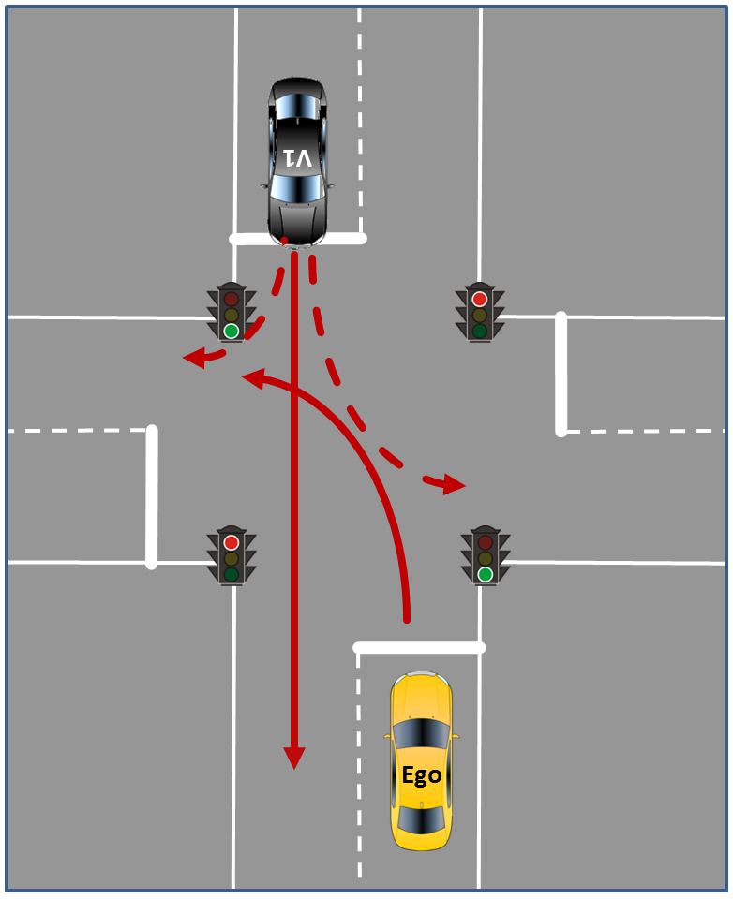
Proposal Test Track Scenarios „Urban“
2.1 Unprotected „left turn“ (in case of right hand traffic)
Situation: The vehicle approaches an intersection in autonomous mode with the intention to perform a left turn. Other Dynamic Objects are present.
Expected Behavior: The vehicle should automatically activate the left direction indicator when slowing down. Then, the vehicle yields considering the traffic rules from the corresponding country and turns left.
Initial Condition: The vehicle follows the ego-lane and is heading an intersection that is controlled by a traffic light without green arrows as status, by a yield sign or without any traffic elements at all.
Final Condition: The vehicle has applied the left turn indicators and turned left according to the traffic rules without endangering oncoming traffic. The vehicle drives on at the new lane.
Excerpt Parameters Test Procedure
INITIAL CONDITIONS:
Infrastructure: Crossing (dimensions, lane markings, design and position of traffic lights) → see e.g. EU-Project PROSPECT, design and position of speed sign on ego lane before the crossing, area before crossing to allow smooth acceleration of Ego to reach initial speed
Environment: Ambient temperature, track temperature, wind speed, ambient illumination etc.
Ego-Vehicle: Initial speed/speed range to approach the crossing
TEST MANEUVER:
Vehicles V1: Speed/speed range, differential position/trajectory to Ego
Options: Number and dimension of gaps between vehicles V1, trajectory of V1 (drive straight or left/right turn)
Justification:
Criteria 1: Technical difficulty/complexity for the system to detect/manage the situation
Path of other vehicles is difficult to predict/sense; high differential speeds
Criteria 2: Injury/crash severity
High severity due to side impact and high speeds of involved vehicles

Slide 39
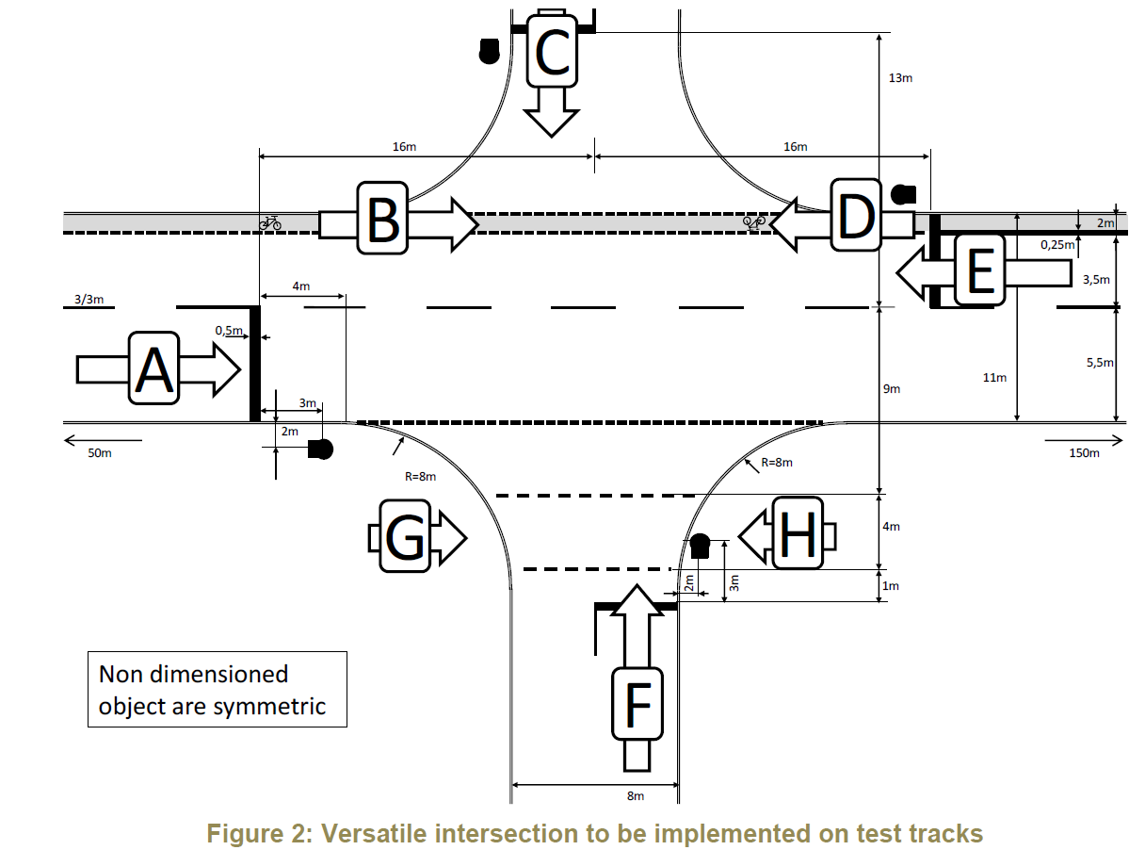
EU Project PROSPECT* – Standard Intersection Layout
EU-Project PROSPECT issued a draft proposal for standard intersection layout : “Deliverable D7.4 proposes an intersection geometry that allows the conduction of all intersection test cases with no need to manipulate the lane markings in-between tests: only tracks for Vehicle-Under-Test and VRU Dummy need to be reprogrammed, object positions need to be shifted and implemented.”
OICA proposes to consider this intersection geometry proposal for test scenario 2.1 and 2.3
Open point: Different intersection layouts needed for other countries like USA/CAN, China, etc.?
* Source: Proactive Safety for Pedestrians and Cyclists, European Commission, Eigth Framework Programme, Horizon 2020, GA No. 634149; Deliverable D7.4

Slide 40
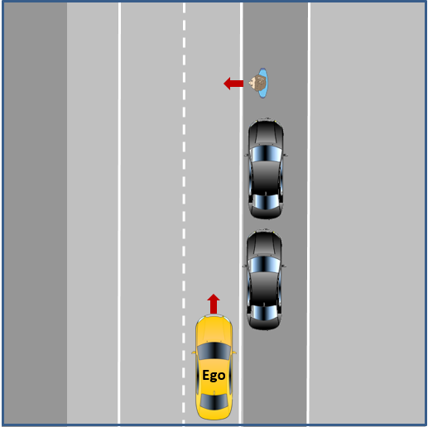
Proposal Test Track Scenarios „Urban“
2.2 Obstructed Pedestrian crossing (without traffic lights, without pedestrian walkway)
Situation: The vehicle follows in autonomous mode the ego-lane and approaches a gap after parked vehicles, where an obstructed pedestrian passes the street.
Expected Behavior: The vehicle shall stop in a safe manner in order to avoid the collision. The vehicle can continue the drive, when the driving path is clear.
Initial Condition: The vehicle follows the ego-lane and is heading towards an obstructed pedestrian behind parked vehicles.
Final Condition: The vehicle continues its drive without violating traffic rules as well as safety and comfort criteria.
Excerpt Parameters Test Procedure
OICA proposal:
Use established EuroNCAP maneuver CPNC-50 scenario (running child from nearside from obstruction vehicles (see Test Protocol AEB VRU systems, Version 2.0.2, November 2017)
A test protocol with all parameters is already available. A carry-over to automated driving is possible with the only deviation that the ego vehicle speed would not be constant throughout the scenario and therefore the pedestrian target’s trajectory needs to be synchronized with the Ego vehicle speed (the automated driving system can automatically reduce speed in the particular driving situation).
Child pedestrian target: Specified by NCAP, speed 5 kph, synchronized trajectory depending on Ego vehicle trajectory
Justification:
Criteria 1: Technical difficulty/complexity for the system to detect/manage the situation
Dynamic obstacle test including obstruction of the pedestrian (child) dummy by other vehicles/objects on the side of the road is difficult to predict/sense; high differential speeds
Criteria 2: Injury/crash severity
High severity for an unprotected pedestrian if the vehicle does not safely stop

Slide 41
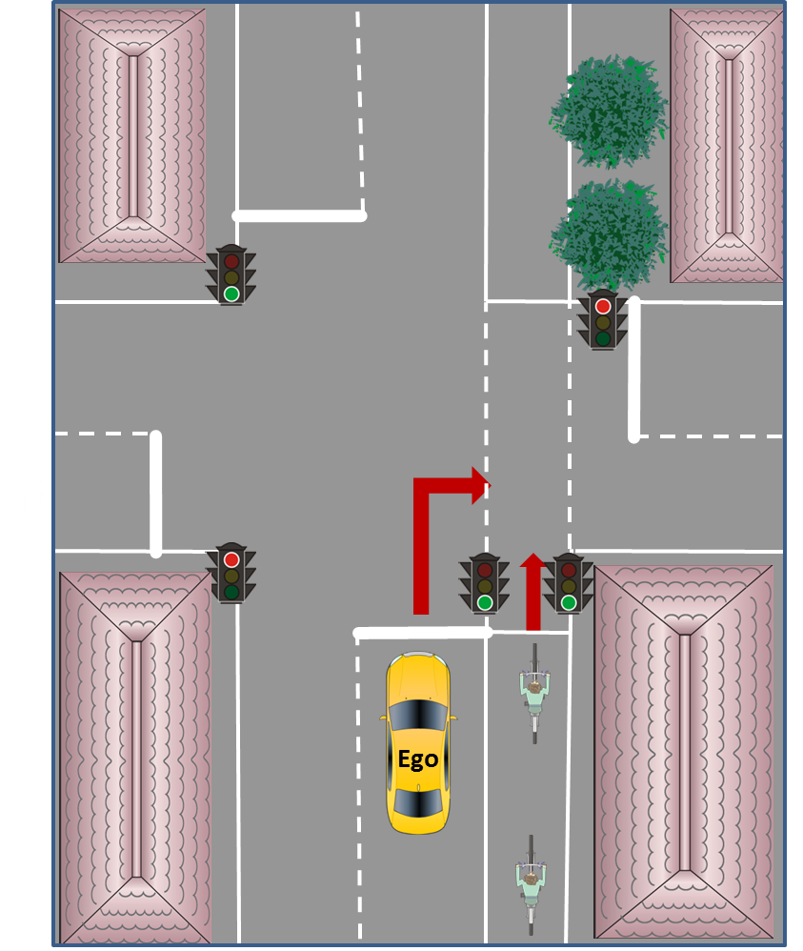
Proposal Test Track Scenarios „Urban“
2.3 Cyclist test in combination with right turn
Situation: The vehicle is driving with [50 km/h] in autonomous mode on a priority road and approaches an intersection (vehicle has right of way or traffic light “green”) to perform a right turn. A cyclist is driving with [15 km/h] in the same direction using a separate bicycle lane adjacent to the priority road and wants to keep straight on across the intersection. A second bicycle is following with a [20m] gap to the first, also driving with [15km/h].
Expected Behavior: The vehicle should automatically activate the right direction indicator when slowing down, first stop and let the first bicycle pass and then use the gap between the first and the second cyclist in order to turn right.
Initial Condition: The vehicle follows the ego-lane.
Final Condition: The vehicle has applied the right turn indicators and used the gap between the two cyclists for turning right. The vehicle drives on at the new lane.
Excerpt Parameters Test Procedure
INITIAL CONDITIONS:
Infrastructure: Crossing (dimensions, lane markings for both vehicles and bicycles, design and position of traffic lights → see e.g. PROSPECT intersection which includes bicycle lane), design and position of speed sign on ego lane before the crossing, area before crossing to allow smooth acceleration to reach initial speed
Environment: Ambient temperature, track temperature, wind speed, ambient illumination etc.
Ego-Vehicle: Initial speed/speed range to approach the crossing
TEST MANEUVER:
Bicycles: Speed, synchronized trajectory depending on Ego vehicle trajectory, dimension of gap between bicycles, target’s dimension (NCAP bicycle target available)
Justification:
Criteria 1: Technical difficulty/complexity for the system to detect/manage the situation
Path of the cyclist that has a certain (parallel) distance to the road is difficult to predict/detect, relatively high differential speeds
Criteria 2: Injury/crash severity
High severity for a protected/unprotected cyclist if the vehicle does not safely stop before making the right turn

Slide 42
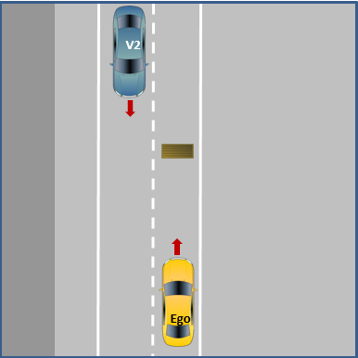
Proposal Test Track Scenarios „Urban“
2.4 Obstacle test
Situation: The vehicle follows in autonomous mode the ego-lane and reacts on static objects located ahead of the vehicle on the driving lane while there is oncoming traffic on the neighbor lane (so that there is not at all times a possibility for evading the static object). The static object may have different sizes, but is not moved by itself.
Expected Behavior: The vehicle has to decide if the static object is traversable or not. If it is not traversable, the vehicle has to decide when it has to stop and when to evade/drive around the static object.
Initial Condition: The vehicle follows the ego-lane. The vehicle is heading a static object in lane.
Final Condition: The vehicle has just followed the ego-lane if the static object is traversable. If it is not traversable, the vehicle has safely (without endangering oncoming traffic) driven around the obstacle to follow the ego-lane.
Excerpt Parameters Test Procedure
INITIAL CONDITIONS:
Infrastructure: Lane dimensions and markings, design and position of speed sign on ego lane before stationary object, area’s dimension before object to allow smooth acceleration to reach initial speed
Environment: Ambient temperature, track temperature, wind speed, ambient illumination etc.
Ego-vehicle: Initial speed/speed range to approach the stationary object
TEST MANEUVER:
Vehicle V2: Speed; synchronized trajectory depending on Ego vehicle trajectory
Stationary object: Dimension (traversable/non-traversable; extent of lane blockage), position within the lane
Options: Number of approaching vehicles V2, different differential speeds Ego to wait vs. Ego to evade immediately), additional vehicles in front of Ego
Justification:
Criteria 1: Technical difficulty/complexity for the system to detect/manage the situation
Detect the stationary obstacle and then drive around/evade including consideration of oncoming traffic is difficult! Note: The dynamic object that suddenly crosses the road would be covered by 2.2. and requires different technical capabilities.
Criteria 2: Injury/crash severity
High severity for drivers/passengers due to oncoming traffic

Slide 43
Next steps
Agree on how to handle certain options/variants of the test scenarios in a next step to have transparency what elements the scenarios should include
Based on this, continue working on a draft specification of reproducible tests for the scenarios 2.1 – 2.4 (i.e. define numerical values/parameters like e.g. speed and distances, road infrastructure, definition of objects, pass/fail criteria, test equipment etc.).
OICA proposes to consider the intersection geometry proposal of the EU-Project PROSPECT for test scenario 2.1 and 2.3 and not to start a separate activity. → Are different intersection layouts needed for other countries like e.g. USA/CAN, China, etc.? What is the expectation of the Contracting Parties?
Test Scenario 2.2 (Obstructed Pedestrian crossing): OICA proposes to use the existing EuroNCAP maneuver CPNC-50 scenario (running child from nearside from obstruction vehicles, see Test Protocol AEB VRU systems, Version 2.0.2, November 2017) with the only deviation that the ego vehicle speed would not be constant throughout the scenario (initial speed would be fixed, but the automated driving system may then automatically adapt its speed to the particular driving situation)

Slide 44
Testing of autonomous/automated driving systems on proving grounds – The issue of “testability” – OICA views

Slide 45



Testability on proving grounds - Introduction
Background:
Especially L3-L5 features are linked to a dedicated ODD* and can only be activated and operated within this ODD*.
This issue is a general and use-case independent, issue that even affects ACSF (e.g. CAT C, B2), but has not been resolved, yet.
Proving grounds:
Are typically not part of the geographic ODD*
Do typically not reflect other technical ODD* requirements
Are typically not included in high definition maps
Consequence: If dedicated ODD* conditions/premises are not fulfilled, the automated driving system cannot be activated on proving grounds and therefore not be tested
ODD
Proving Ground
Example illustration
*Operational Design Domain

Slide 46
Testability on proving grounds - Options
Option | 1 | 2 | 3 | 4 | 5
Description | Enable/adapt both proving ground infrastructure and high definition maps to allow for physical testing of ADS equipped vehicles | Test maneuvers with ADS equipped vehicles on public streets within the operational design domain | Limit physical testing of ADS equipped vehicles to OEM-specific proving grounds | Enable ADS equipped vehicles with a so called „test mode“ (that allows remote operation) for physical testing on any proving ground | Enable/adapt specific test vehicles by applying SW-modifications (e.g. activate SCN-coding) for physical testing on any proving ground
Advantages | + Authorities/agencies can independently from OEMs conduct compliance tests with any desired ADS equipped vehicle on specific proving grounds + Testability of series systems → no modification to systems/software necessary | + Authorities/agencies can independently from OEMs conduct compliance tests with any desired ADS equipped vehicle + Testability of series systems → no modification to systems/software necessary | + Reduced implementation efforts for OEMs + Testability of series systems → no modification to systems/software necessary + No difficulties with OEM-specific attributes in high definition maps as considered by OEM-proving grounds | + Authorities/agencies can independently from OEMs conduct compliance tests with any desired ADS equipped vehicle on proving grounds | + Reduced implementation efforts for OEMs + Flexibility
Disadvantages/ Challenges | - High implementation efforts for OEMs - Handling of OEM-specific attributes (IP-issue?) in high definition maps that need to be reflected by proving grounds - Handling of new proving grounds that were not existent at the time of production (map update of proving ground) - Maintenance issues | - Road blocking may be possible in individual cases, but not realistic/practical as general solution worldwide - Safety reasons in case of on road-tests and many other things likely not easy/practical to test on public roads | - Independent execution of certification tests not possible for authorities/agencies – causes problems for rating/ compliance-Testing, CoP und market surveillance - Not realistic/practical as solution worldwide | -Risk of unauthorized access/manipulation and security threat due to external interface - No representative series systems/software | - No representative series systems/software - Independent execution of certification tests not possible for authorities/agencies – causes problems for rating/ compliance-Testing, CoP und market surveillance
OICA’s conclusion: Simultaneous investigation of option 3 (short-term solution) and option 1 (long-term solution ) seems to be useful and reasonable approach

Slide 47
Next steps
What is the expectation of the Contracting Parties regarding testability on proving grounds?
Can it be assumed that certification agencies/authorities etc. want to be able to independently test and assess vehicles/automated driving systems on certain proving grounds (e.g. relevant for certification-tests, in-use-compliance-tests, conformity of production, rating tests NCAP, etc.)?
If yes, option 1 requires that proving ground infrastructure and attributes in proving ground maps fulfill certain harmonized criteria to enable testability of different kinds of systems of different manufacturers
The discussion on standardization of such criteria/map attributes needs to start as soon as possible and is expected to take a longer time as several technical issues need to be properly resolved (e.g. handling of OEM specific attributes, handling and transferring of map data to the different kinds of systems, etc.)
Would a combination of option 1 and 3 be an acceptable approach? E.g. Option 3 as a short- and midterm solution and option 1 as a long-term solution? → both options should be investigated and developed simultaneously

Slide 48
Real-World-Test-Drive

Slide 49
Real World Test Drive – OICA views

Slide 50
Introduction/basis for discussion
The next slides are based on the document “Real world test drive” (TFAV-SG2-01-02) that OICA provided to the TF AutoVeh meeting in Den Haag.
The intention of this presentation is to start the discussion and explain a proposal on how a real world test drive can fit into the overall concept for the certification of AVs developed by OICA.
Several conceptual issues that were raised during the meeting. OICA was asked to further develop / clarify these items.
This updated presentation includes these further explanations to the original document. New sections appear in blue font.

Slide 51
Road Test for AVs: Understanding its Role in the Certification Process
What is the road test supposed to demonstrate? What is its role in the entire certification process?
What is the suggested content?
Which assessment approach is considered?
How could the road test look like from a procedural and timing perspective?

Slide 52
What is the road test supposed to demonstrate? What is its role in the entire certification process (1/2)?
Hypothesis:
The road test is going to demonstrate the capability of the vehicle to adhere to traffic rules [and maneuvers according to the general expectations of other road users].
This capability is brought to the driving task currently by the experienced / approved driver.

Slide 53
What is the road test supposed to demonstrate? What is its role in the entire certification process (2/2)?
The road test is an integral building block in the assessment and certification of automated vehicles. That said it is not suggested that this is the one and only deciding criteria for certification.
The road test is going to address typical / normal traffic scenarios that a human driver is exposed to on a regular basis.
After this road test the generic „competence“ of the vehicle is documented to adhere to traffic rules and the assessor has the ability to declare if it moves in traffic without becoming an obstacle.

Slide 54
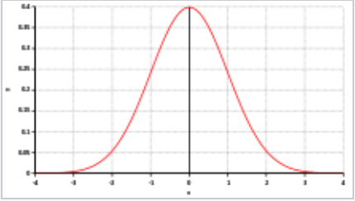
Coverage of Scenarios - to be addressed according to the use case -
„Typical“ Driving –
Real World Test Drive
Demanding Traffic Scenarios –
Physical Tests
Edge Cases –
Simulation
With the approach suggested by OICA all traffic scenarios can be addressed appropriately

Slide 55
Definition of “realistic / Typical / Normal” traffic conditions
> 90 % of all road trips are „un-eventful“ because the driver does not have to deal with challenging scenarios or edge cases
During these trips the adherence to traffic rules, showcasing a behavior that is understood by other road users and participating in the traffic without being an obstacle to other road users is the prime role of the driver, i.e. the automated system in the future.
➔Therefore, traffic scenarios as suggested in the „checklists“ – see below – fullfil this criteria

Slide 56
What is the suggested content?
Hypothesis:
Automated/ autonomous vehicle will not operate at the beginning under all conditions and on all roads. The initial focus will be on the use cases called „highway“ and „urban“ driving.
Consequently, the content of the road test will have to be adjusted to these use casses (i.e. test scenarios of traffic situations).
Note: the minutes of the SG2 session state that the group should „start with urban situations, while ACSF continues with highway situations.“

Slide 57
What is the suggested content?
The selected scenarios will have to be derived after assessment from various sources. Ultimate goals is to generate a data base filled with traffic scenarios with which the statistical relevance of scenarios can be assessed and changes to traffic cenarios can be document.
A vehicle can – based on the input of the vehicle manufacturer – be nominated for one or more use case related road tests.
Limitations of the automated / automonous system will be reflected, assessed and documented based on the input provided by the vehicle manufacturer. This includes weather conditions, speed restrictions, non supported roads (e.g. tunnels). For identified limitations, the HMI approach needs to be assessed during the real world test drive to ensure that an appropriate hand-over is initiated by the system and that the system can recognise the limitations.

Slide 58
Which assessment approach is considered?
Hypothesis:
Based on a checklist the assessor exposes the vehicle to a pre-defined number of mandatory scenarios to maintain objectivity and comparability between road tests. Additional scenarios (supplementary ones) can be tested as well according to availability.
Comments should be provided on the checklist after a scenario has been completed indicating whether it was successful or not. Additional comments – if necessary – can be provided as well.

Slide 59
OICA proposal for checklists as integral part of the road test
Brief description of test route/location
Date/time of test drive
Item # | Situation | Pass |  | Comments (must be filled out in case of “no/unclear”)
 |  | Yes | No/ unclear
Part A: mandatory |  | All lines in Part A have to be evaluated during the test drive
HA.1 | Entering the highway
HA.2 | Following other vehicle in same lane
HA.3 | Passing a slower vehicle: lane change/Passing/merging back in previous lane
HA.4 | Adapting to changing speed limits
HA.5 | Merging from an ending lane
HA.6 | Exiting the highway
HA.7
HA.8
HA.9
HA.10
Suggests splitting into a mandatory and a supplementary section
All mandatory aspects need to be covered while supplementary aspects can help to refine the understanding of the vehicle performance in real traffic
Part B: supplementary |  | If any of the following situations is encountered during the test drive this shall be noted in the respective line. Additional lines may be added for situations not listed which were observed.
HB.1 | Situation involving an emergency vehicle (police, ambulance, fire brigade)
HB.2 | Policeman or roadman directing traffic
HB.3 | Objects/obstacles on the road (e.g. lost cargo)
HB.4 | Driving through construction site (if possible with modified lane markings)
HB.5 | Driving through area with no/bad lane markings
HB.6 | Safely approaching end of traffic jam
HB.7 | Driving in traffic jam
HB.8 | Driving through area with bad road surface conditions
HB.9
HB.10
Additional considerations:
Across the markets (e.g. the EU) similar but not same traffic rules and expected behaviors apply (example: how to approach a pedestrian crossing and when to stop)
➔OICA suggests to not make this part of the road test but consider this for the „Audit“ pillar

Slide 60
Examples for a Checklist – Highway driving (1/2)
Brief description of test route/location
Date/time of test drive
Item # | Situation | Pass |  | Comments (must be filled out in case of “no/unclear”)
 |  | Yes | No/ unclear
Part A: mandatory |  | All lines in Part A have to be evaluated during the test drive
HA.1 | Entering the highway
HA.2 | Following other vehicle in same lane
HA.3 | Passing a slower vehicle: lane change/Passing/merging back in previous lane
HA.4 | Adapting to changing speed limits
HA.5 | Merging from an ending lane
HA.6 | Exiting the highway
HA.7
HA.8
HA.9
HA.10

Slide 61
Examples for a Checklist – Highway driving (2/2)
Part B: supplementary |  | If any of the following situations is encountered during the test drive this shall be noted in the respective line. Additional lines may be added for situations not listed which were observed.
HB.1 | Situation involving an emergency vehicle (police, ambulance, fire brigade)
HB.2 | Policeman or roadman directing traffic
HB.3 | Objects/obstacles on the road (e.g. lost cargo)
HB.4 | Driving through construction site (if possible with modified lane markings)
HB.5 | Driving through area with no/bad lane markings
HB.6 | Safely approaching end of traffic jam
HB.7 | Driving in traffic jam
HB.8 | Driving through area with bad road surface conditions
HB.9
HB.10

Slide 62
Examples for a Checklist – Urban Driving (1/2)
Brief description of test route/location
Date/time of test drive
Item # | Situation | Pass |  | Comments (must be filled out in case of “no/unclear”)
 |  | Yes | No/ unclear
Part A: mandatory |  | All lines in Part A have to be evaluated during the test drive
UA.1 | Wake/initial start of journey (with objects in close-proximity of the vehicle)
UA.2 | Pass intersection regulated by traffic light
UA.3 | Pass intersection regulated by signs
UA.4 | Pass intersection without explicit regulation concerning right of way
UA.5 | Merge lane (two flows of traffic become one)
UA.6 | Make a left turn from a priority road (in case of right hand traffic)
UA.7 | Make a turn which requires previous lane change
UA.8 | Make a turn which crosses a bicycle path / pedestrian walkway
UA.9 | Pass a roundabout
UA.10 | Pass a pedestrian walkway (with pedestrian present)
UA.11 | Park vehicle at destination
UA.12 | Adherence to speed limits
UA.13 | Adherence to stop sign
UA.14 | Adherence to other road signs

Slide 63
Examples for a Checklist – Urban Driving (1/2)
Part B: supplementary |  | If any of the following situations is encountered during the test drive this shall be noted in the respective line. Additional lines may be added for situations not listed which were observed.
UB.1 | Situation involving an emergency vehicle (police, ambulance, fire brigade)
UB.2 | Policeman or roadman directing traffic
UB.3 | Objects/obstacles on the road (e.g. lost cargo)
UB.4
UB.5
UB.6
UB.7
UB.8
UB.9
UB.10

Slide 64
How could the road test look like from a procedural and time perspective?
Hypothesis:
The road test should be aligned with the existing driving test in terms of duration, acceptance and general conditions.

Slide 65
How could the road test look like from a procedural and timing perspective?
Process:
Duration per “use case”: 30-60 Minutes in a realistic traffic environement, i.e. not in the middle of the night or during rush hour.
The assessor identifies the route to be taken and programs the route for the use case to be tested in to the navigation system.
During the road test the scenarios are being checked (not necessarily in the listed sequence) and assessed. This can include the HMI related questions in case certain limitations of the system have been declared by the OEM.
At the end an overall assessment is provided (successful: yes / no) and potentially additional comments created and recorded.

